Slide 1
Account management system
By Albert Biney

Slide 2
Contents
Requirements
Technologies
Add an Account
List of Accounts (delete)
Edit an Account
Challenges
Demo
Future Improvements
Outcome

Slide 3
Requirements
Add a New Account
Delete an Account
Edit an Account
SpringBoot
Vue.js

Slide 4
technologies
SpringBoot
Vue.js
IntelliJ IDEA
Postman
MySQL
Google Chrome
XAMPP

Slide 5
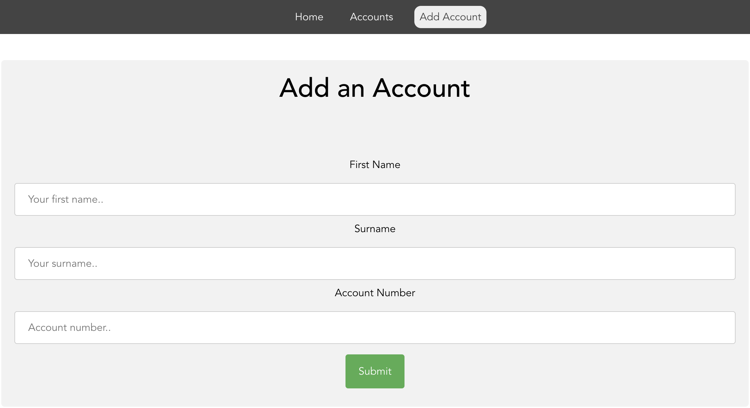
Add an Account

Slide 6
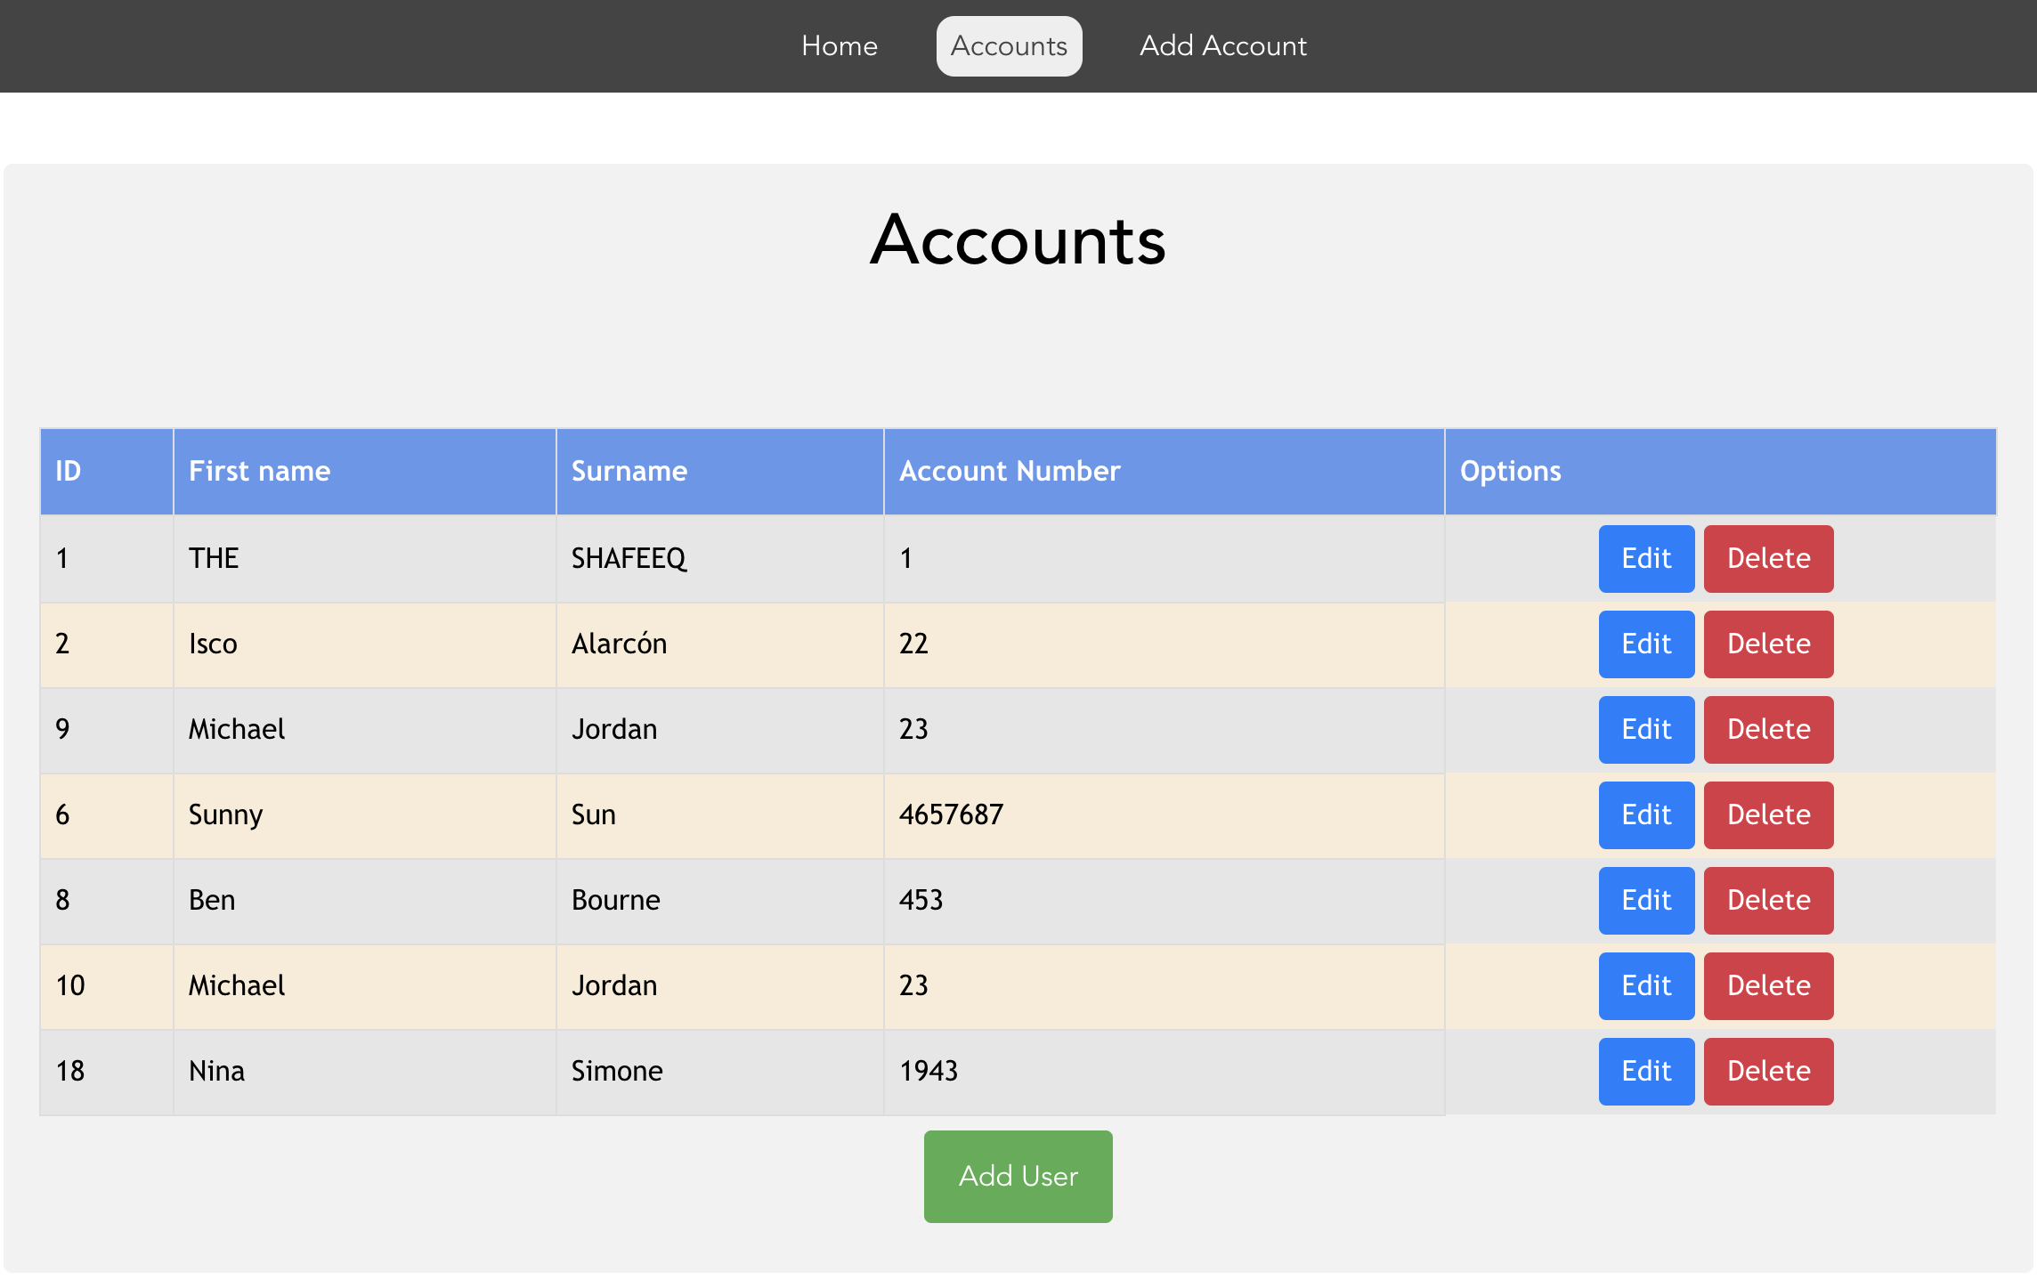
List of Account

Slide 7
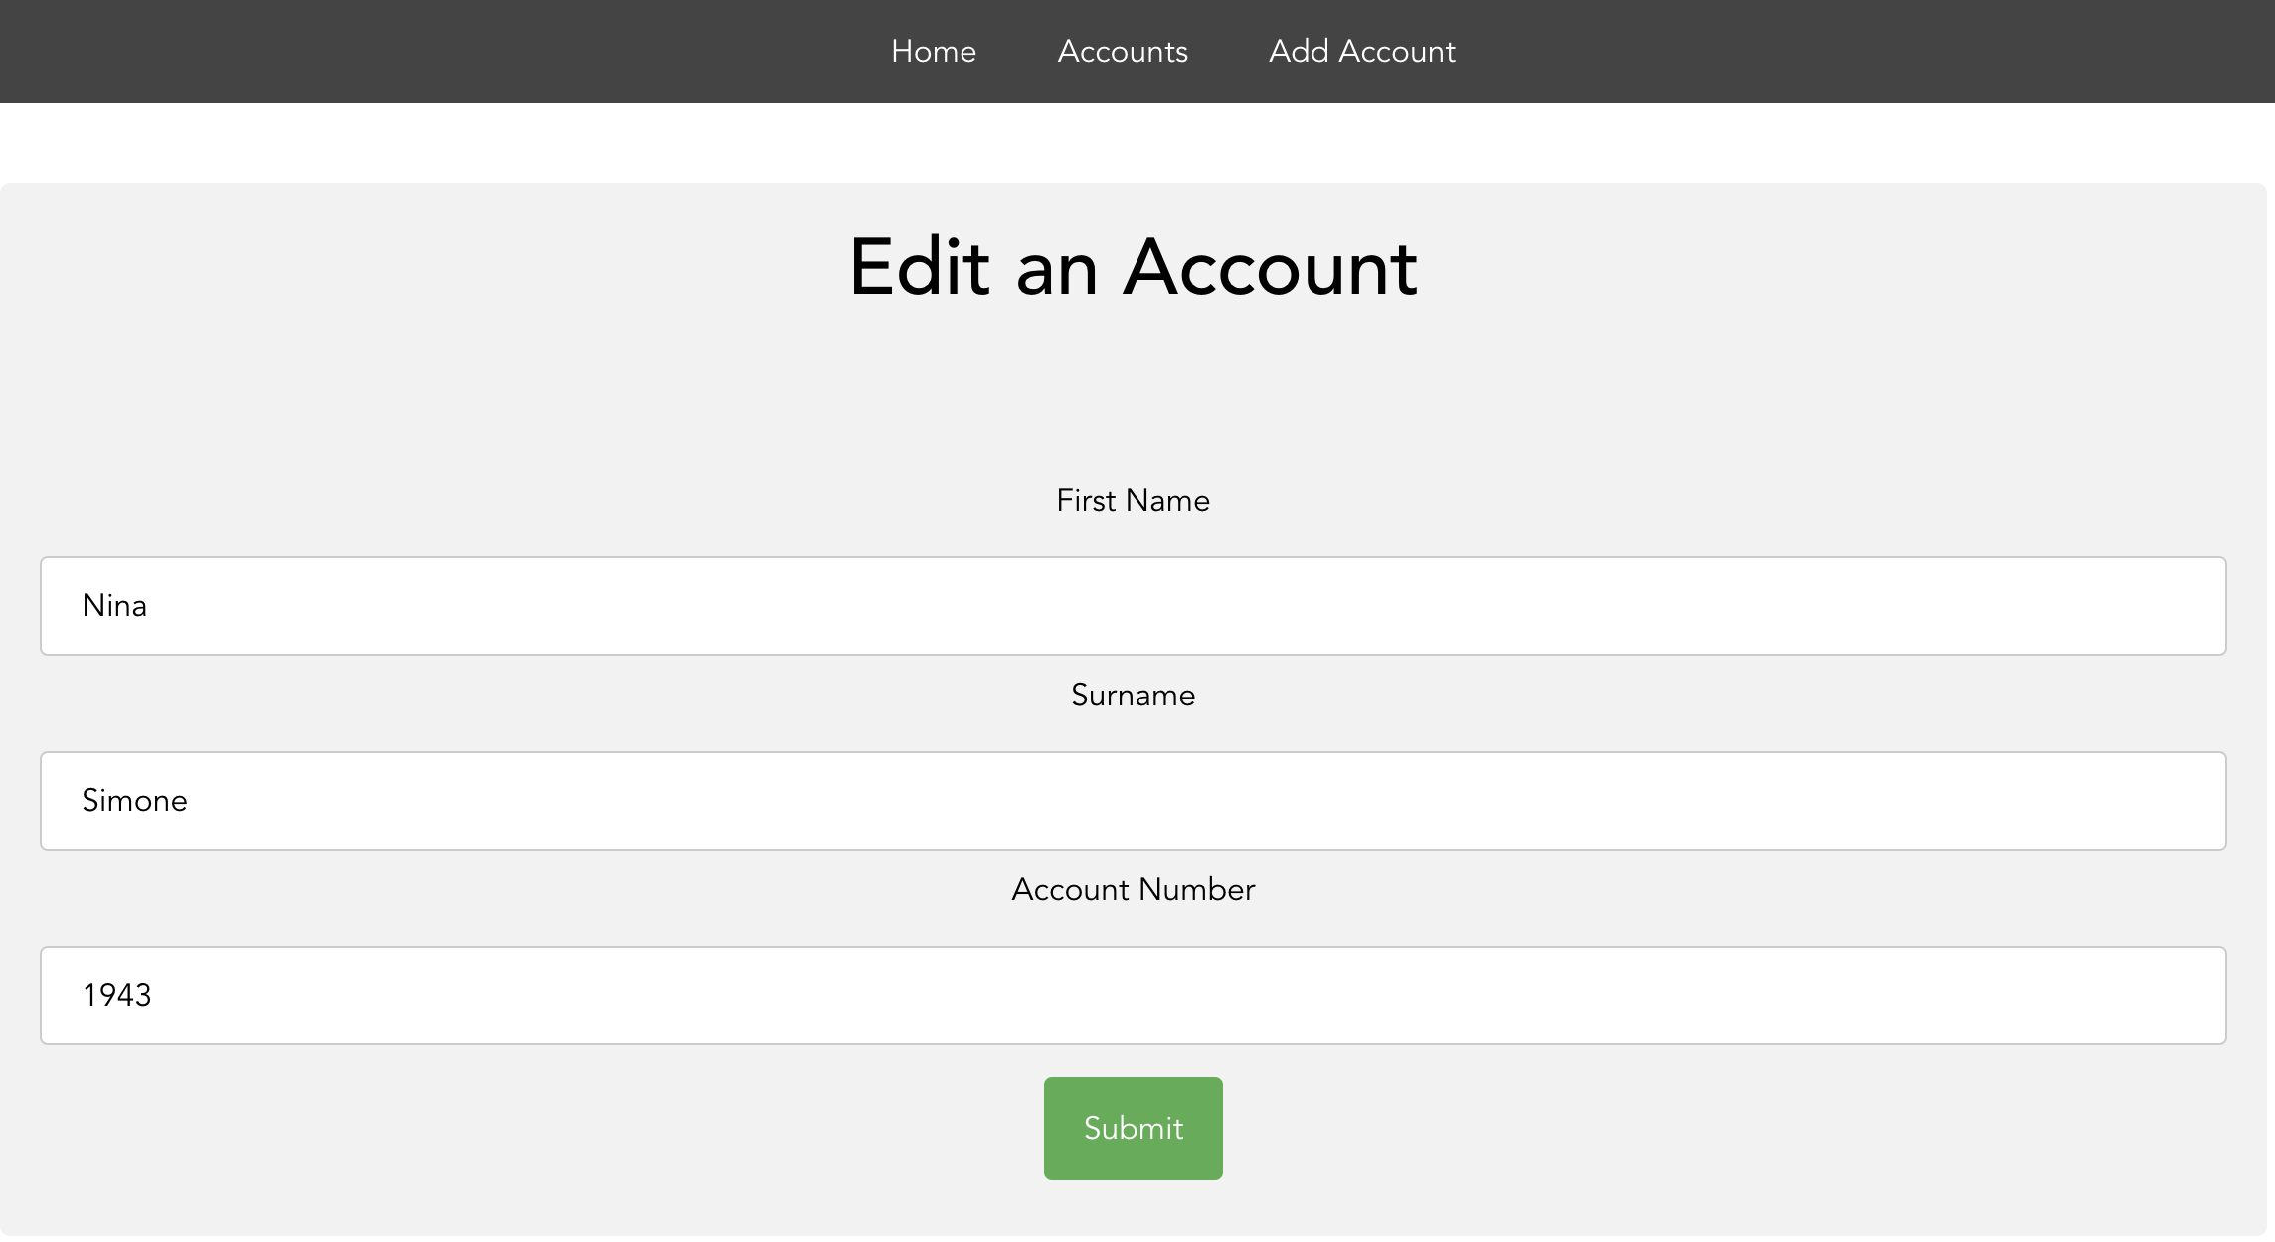
edit an Account

Slide 8
challenges
macOS operating system.
Installation errors with macOS.
Edit an Account.
Slow understanding of BootStrap and Vue.js and how to link technologies to the project.

Slide 9
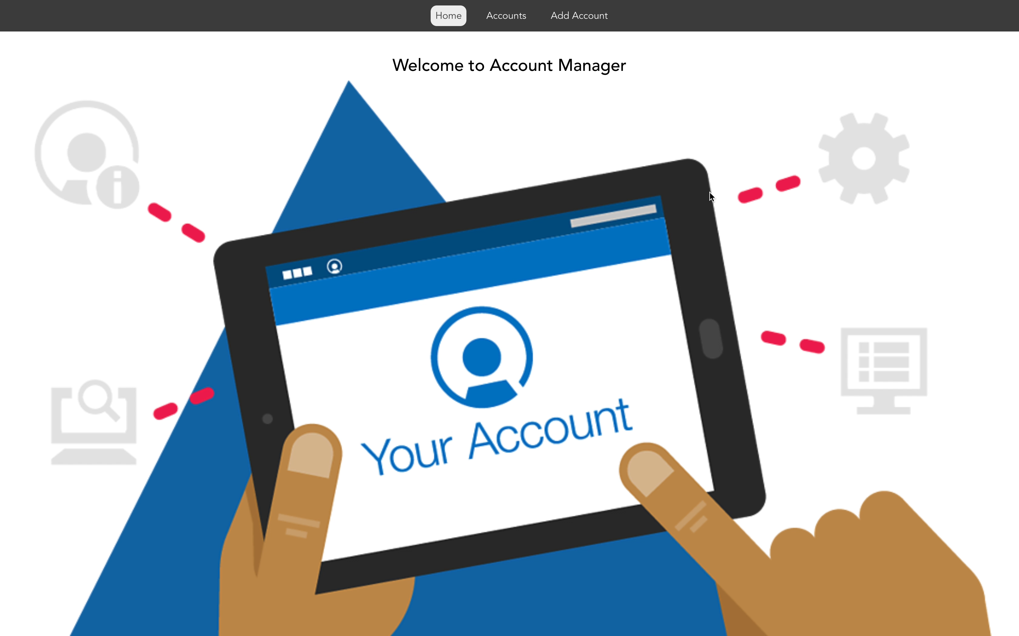
demo

Slide 10
Future improvements
Add Edit an Account feature.
Improved look with more colours.
Login feature.
Search box.

Slide 11
outcome
Thoroughly enjoyed the project and understood it more towards the end.
Learned the importance and usefulness of technologies and how it helps to make developing easier.
Working project apart from one feature.
New use of technologies.

Slide 12


